Slide 1
Premier League Table Prediction using Linear Regression
Prediction of the pl 2021-22 season using previous years dataset.
Mentor-
Ms. Priyanka
Team Members-
Aman Chamola 00113303118
Ankur Bhardwaj 40813303118
Bhavya Gaur 35113303118

Slide 2
Index :-
Introduction
Data Extraction
Data Analysis
Data Cleaning
Data Mining
Data Visualization
What is Linear Regression
Data Modelling
Model Evaluation
Final Prediction
Applications
Progress

Slide 3
Introduction
Data Extraction : extracting/obtaining our data from fotmob.com and then using that we’ll creating our own dataset on MS excel.
Data Analysis : analysing and manipulating the dataset.
Data Cleaning : clean the data, and check if there are any null values or not.
Data Mining : adding new columns and variables to the dataset so that we can have an accurate model.
Data Visualization : using seaborn and matplotlib libraries in python to get the gist of the data and finding correlations between different columns.
Data Modelling : using linear regression model to predict the premier league table points of 2021/22 season. (library used : Sklearn)
Model Evaluation : using R2 score and mapping testing and predicted data on a scatter graph using matplotlib library to check our model evaluation.

Slide 4
Data Extraction
The most important first step in any machine learning project is to obtain good quality data. Different kinds of sources are used for extracting data such as publicly available, data available via an API, data found in some database or in many cases combinations of these methods.
We used Public domains: fotmob.com & understat.com to extract data for our project and then used it to create our own dataset in MS excel.

Slide 5
Data Analysis
Machine Learning is nothing but a method of Data Analysis that automates analytical model building. It is a branch of artificial intelligence based on the idea that systems can learn from data, identify patterns and make decisions with minimal human intervention.
We used Python library Pandas
Pandas is an open-source library with High performance, easy-to-use Data Structures, and Analysis tools for Python. Data Science works like Calculating statistics, cleaning data, etc. It is highly used in Data Mining and Preparation but less in Data Modeling & Analysis.

Slide 6
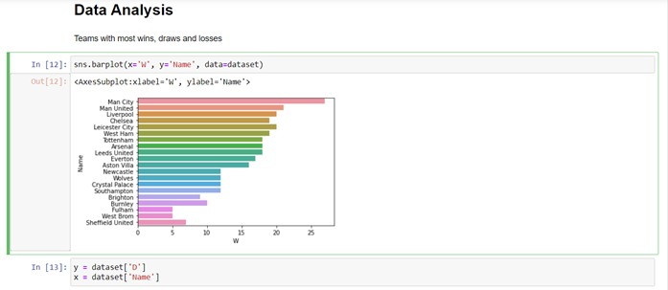
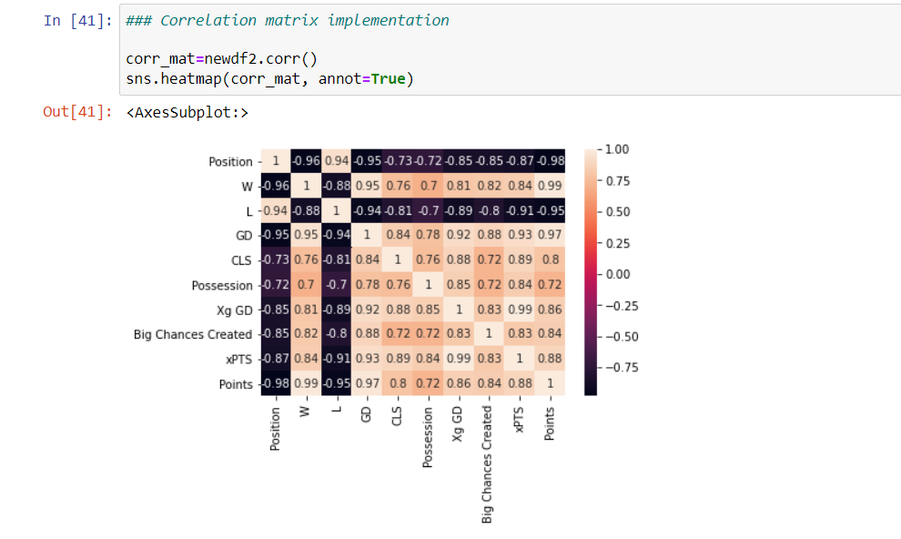
Data Analysis of our project :-
Some Columns Description:
W: Win D: Draw
L: Loss GF: Goals For (Goals Scored)
GA: Goals Against (Goals Conceded) GD: Goal Difference
Xg: Expected Goals Xg GD: Expected Goal Difference
xPTS: Expected Points CLS: Clean Sheets

Slide 7
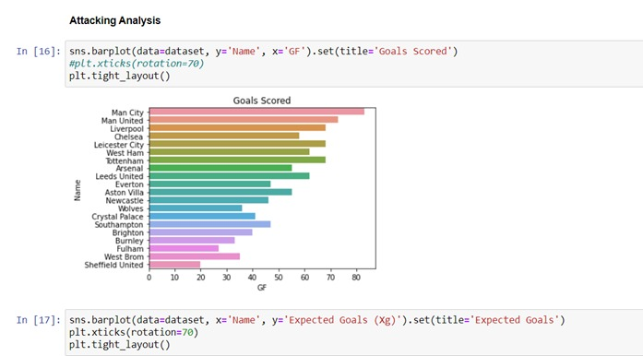
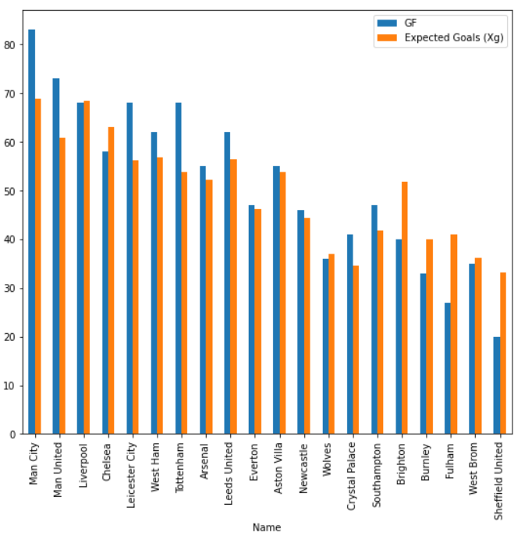
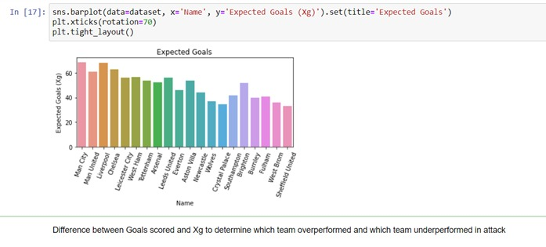
Attacking Analysis

Slide 8
Data Cleaning
Data cleaning refers to identifying and correcting errors in the dataset that may negatively impact a predictive model. Data cleaning is used to refer to all kinds of tasks and activities to detect and repair errors in the data.
8 Ways to Clean Data Using Data Cleaning Techniques
1. Get Rid of Extra Spaces.
2. Select and Treat All Blank Cells.
3. Convert Numbers Stored as Text into Numbers.
4. Remove Duplicates.
5. Highlight Errors.
6. Change Text to Lower/Upper/Proper Case.
7. Spell Check.
8. Delete all Formatting.

Slide 9
Data Mining
Data Mining is a crucial part of Machine Learning, and it is used to find valuable patterns and trends hidden within vast volumes of data. It employs advanced algorithms to uncover relevant data patterns.
Data Mining is performed on certain data sets by humans to find interesting patterns between the items in the data set. It uses techniques created by machine learning for predicting the results while machine learning is the capability of the computer to learn from a minded data set.
We added some new columns and variables in our data set so that we can have an accurate model.

Slide 10
Data Visualization
Data visualization is a graphical representation that contains the information and the data. By using visual elements like charts, graphs, and maps, data visualization techniques provide an accessible way to see and understand trends, outliers, and patterns in data.
It is important to understand how data is used in a particular machine learning model, how it helps in analyzing it. Facets is an open-source python library that can be used to visualize, analyze the data easily without much effort.
Some Data Visualization techniques are :-
1) Area Chart. 2) Bar Chart.
3) Box-and-whisker Plots. 4) Bubble Cloud.
5) Bullet Graph. 6) Cartogram.
7) Circle View. 8) Dot Distribution Map.
We have used seaborn and matplotlib libraries in python to get the gist of the data and finding correlations between different columns.

Slide 11
Data Modelling
A machine learning model is a file that has been trained to recognize certain types of patterns. You train a model over a set of data, providing it an algorithm that it can use to reason over and learn from those data.
Data modeling is the process of creating a visual representation of either a whole information system or parts of it to communicate connections between data points and structures.
For Our project, we used linear regression model to predict the premier league table points of 2021/22 season. (library used : Sklearn)

Slide 12
What is Linear Regression?
It is a statistical method that is used for predictive analysis. Linear regression makes predictions for continuous/real or numeric variables such as sales, salary, age, product price, etc.
Linear Regression is much similar to the Logistic Regression except that how they are used. Linear Regression is used for solving Regression problems, whereas Logistic regression is used for solving the classification problems.
Linear regression algorithm shows a linear relationship between a dependent (y) and one or more independent (x) variables, hence called as linear regression. Since linear regression shows the linear relationship, which means it finds how the value of the dependent variable is changing according to the value of the independent variable.
The linear regression model provides a sloped straight line representing the relationship between the variables. Consider the below image:
Linear Regression is a significant machine learning algorithm because it has become a proven way to scientifically and reliably predict the future.

Slide 13
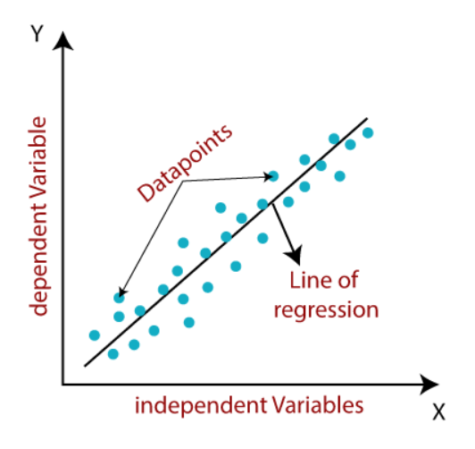
The linear regression model provides a sloped straight line representing the relationship between the variables. Consider the below image:
Y = mx + c

Slide 14
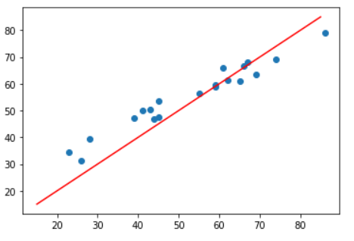
Model Evaluation
Model Evaluation is the process through which we quantify the quality of a system's predictions. To do this, we measure the newly trained model performance on a new and independent dataset. This model will compare labeled data with it's own predictions.
Below Given Graph shows our model’s evaluation.

Slide 15
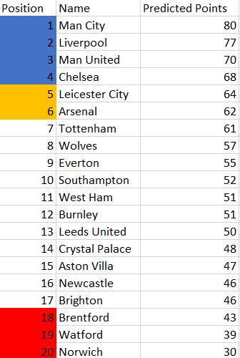
Final Prediction
Final predicted table of Premier League 2021-22 season –
Top 4 teams – UCL qualification
5th-6th – UEL qualification
Bottom 3 - Relegated

Slide 16
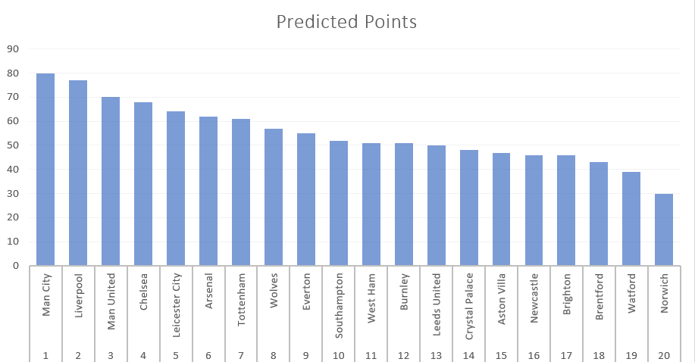

Slide 17
Applications
Weather prediction.
Foreseeing Trends.
Rate of Houses prediction.
Student’s Performance based on their activities.
Impact of blood alcohol content on coordination.

Slide 18
Progress
We’ve analyzed and as well as cleaned the data.
In data analysis, we did data mining,data cleaning and data visualization. In data cleaning we remove the nan values in the dataset, in data mining we single out the desired data for further operation. And in data visualization we visualized our data and compared different columns using python libraries like matplotlib and seaborn.
We’ve built a model using linear regression to make predictions in the dataset using Sklearn library in python.
We’ve done preliminary model testing to determine our model’s efficiency.
We’ve saved the dataframe to csv file format as our final predicted PL 21-22 season’s table prediction.

